Slide 1
HDB Resale Analysis
Rent or Sell
Mini Project 1
Mini Project 1
— Group 3 —

Slide 2
Problem Statement
Problem Statement

Slide 3
Problem Statement
Housing Market Dynamics and Trends:
What are the prevailing trends in the Singapore housing market concerning resale prices and property types?
What are the implications of these trends for clients in terms of decision-making of rent or sell?

Slide 4
Data understanding
Data understanding

Slide 5
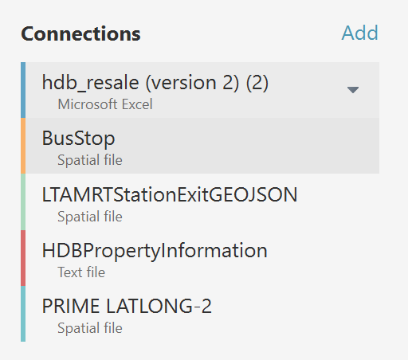
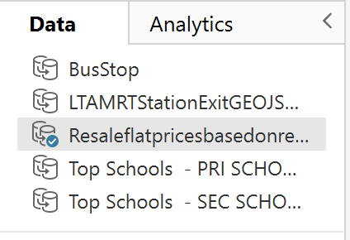
Dataset used
hdb_resale.csv
HDBPropertyInfo.csv
MRTStationExit.geojson
BusStop.shp
Prim School.geojson
Sec School.geojson
Prime_Location.geojson
Resaleflat.csv - used as there are data on flats pricing and general data on it
HDBPropertyInfo.csv - used to show more detailed info on the hdb and its surrounding.
BusStop.geojson - used to mark the location of the bus stops on the map.
MRTStationExit.geojson - used to mark the location of MRT Exits on the map.
Prim School.geojson - Shows the primary schools in Singapore
Sec School.geojson - Shows the secondary schools in Singapore
Prime_Location.geojson - Shows the prime locations in Singapore

Slide 6
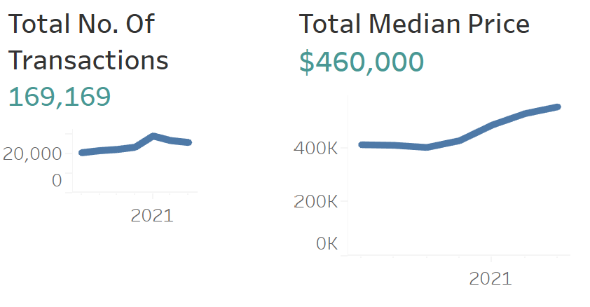
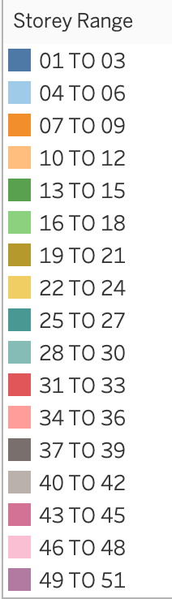
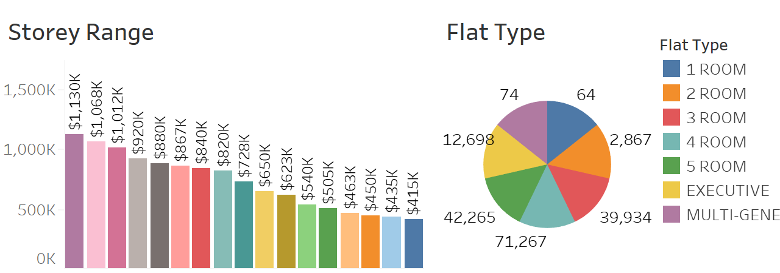
Dataset Summary
169,169 transactions (exclude 2024)
2017 to 2023
460K median price
7 Flat types
01 to 51 Storey Range

Slide 7
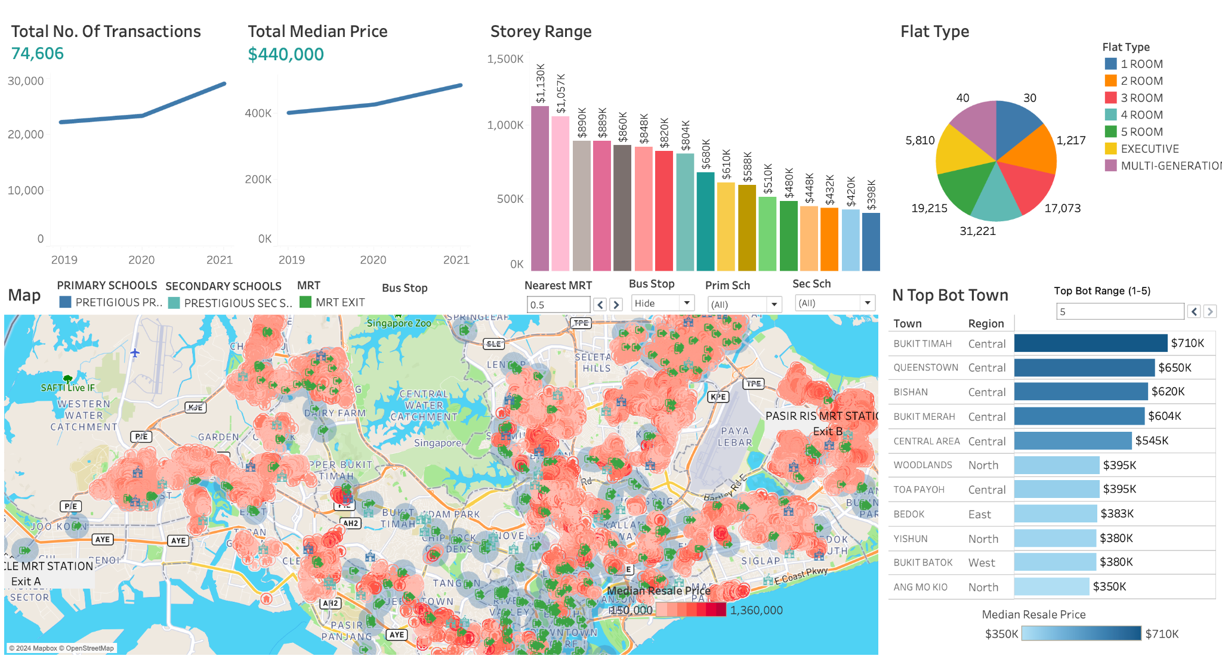
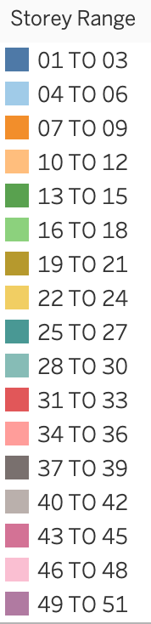
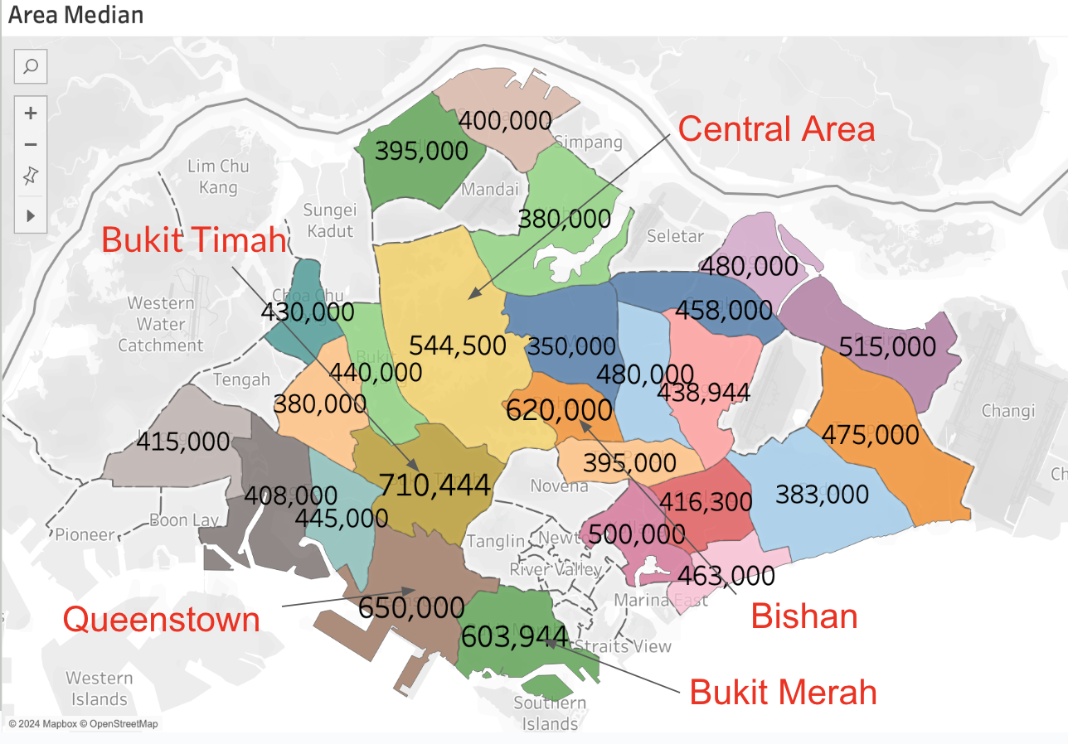
Answering to Q1
Filter by 2019 - 2021

Slide 8
Techniques used
Techniques used

Slide 9
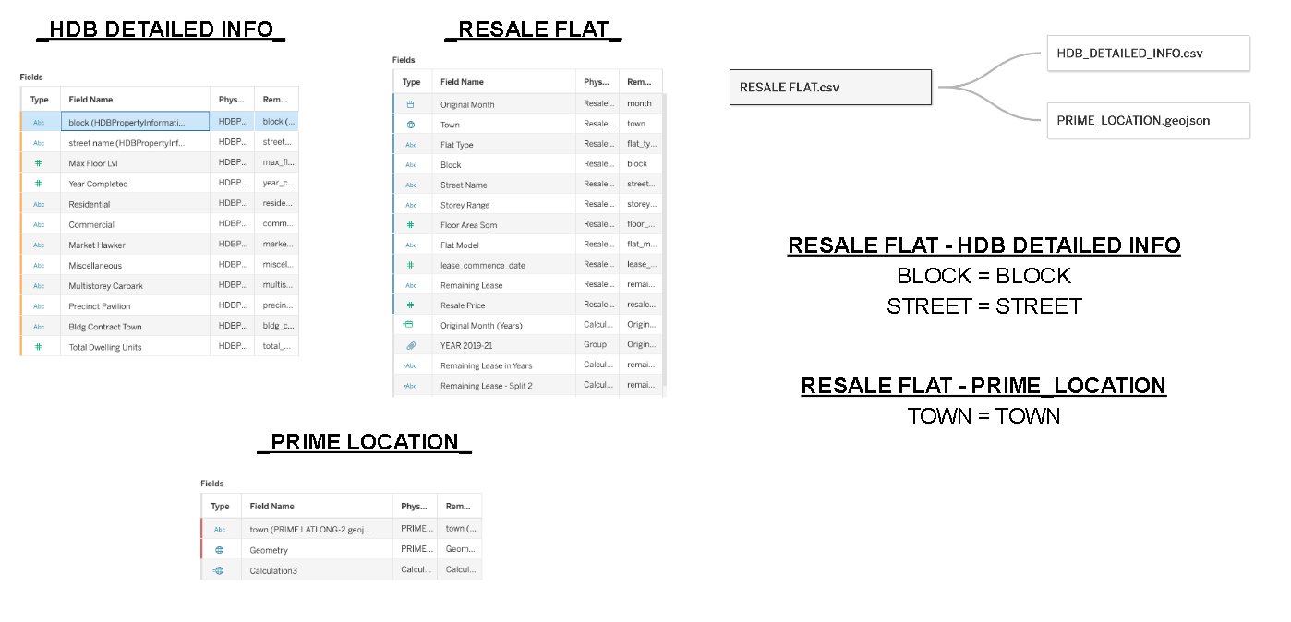
Joining the dataset

Slide 10
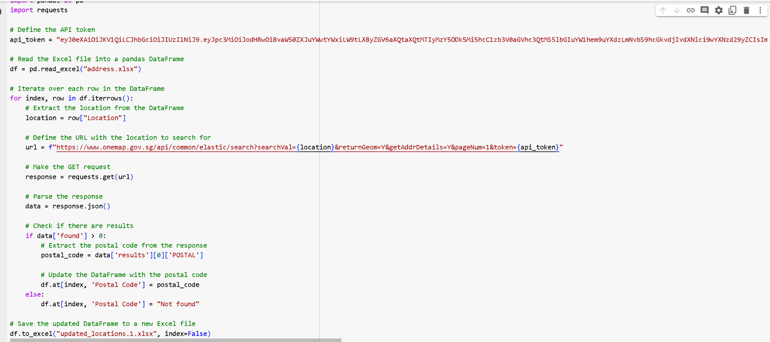
Data Extraction (Postal Code)
Extract postal code from location using OneMap API
Postal codes allow us to pin the location on the map
Notes:
Kaijie

Slide 11
Data Blending
How these affect housing price and why?
MRT Stations:
Enhances convenience & daily commute.
Efficient public transport, lowers travel costs.
Data shows proximity boosts property values.
Schools:
Quality school priority for families.
Properties in esteemed school districts command higher prices.
Stability in property value over time.
Bus Stops:
Improves accessibility & public transport options.
Essential for non-drivers' mobility.
Associated with urban development & infrastructure benefits.

Slide 12
Data cleaning
Data cleaning

Slide 13
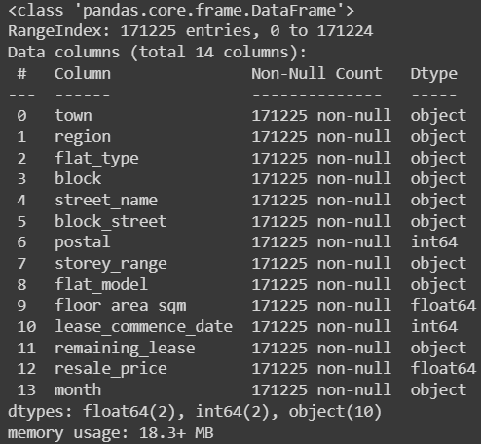

Data - Label Encoding
Transform all categorical variables into numericals.
Will be used for Correlation Matrix.
Before
After

Slide 14
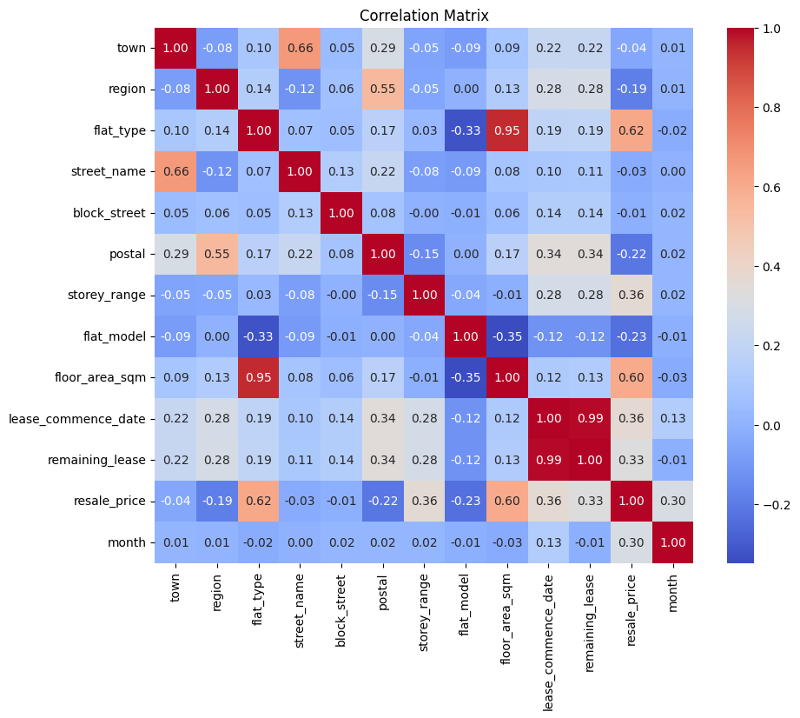
Features Correlation
Finding out which features affect each other
Flat_type: This is how the HDB apartments are categorized; rooms such as 5-rooms, Executives etc.
Floor_area_sqm is the size of the apartment in metres.
Flat_model has the lowest correlation with other features.
May indicate that buyers have other considerations when searching for their homes.
Town/Region has low correlation to resale price, however in practice, many buyers take location into account.
We will use other data sources to explore further.
Notes:
After encoding, we ran the features into a correlation matrix
Our target feature: Resale_price, have high correlation to flat_type and floor_area_sqm; shows that buyers are willing to pay a premium for spacious homes
Flat_model has mostly negative correlation. Shows that it may not be an important factor for buyers
Town/Region has surprisingly low correlation. However, in practice we know location plays an important factor when choosing a home.
We will use other data sources to explore further

Slide 15
Flat Type: Why is it Meaningful
Why did we choose Flat_type?
Distinct Categories: This feature consists of discrete categories ie. “3-room”, “4-room”.
This represents the different residential flats with specific characteristics.
Statistical Analysis: Categorical data allows for the application of statistical techniques appropriate for analyzing qualitative variables.
Eg. Chi-square tests, logistic regression etc.
Real Estate Norms: Categorization aligns with industry practices.
Standardized category for buyers and sellers (eg. Executive, 5-rooms, 4-rooms etc.)
Notes:
Flat_types consist of categorical data, it represents the apartments with specific characteristics
Statistical software like R and Python provide tools to handle categorical data efficiently,
making it easier to analyze and draw conclusions from this type of information.
The realtors’ industry standard: This aligns with what the industry standard practice and allows easy comparison and benchmarks.

Slide 16
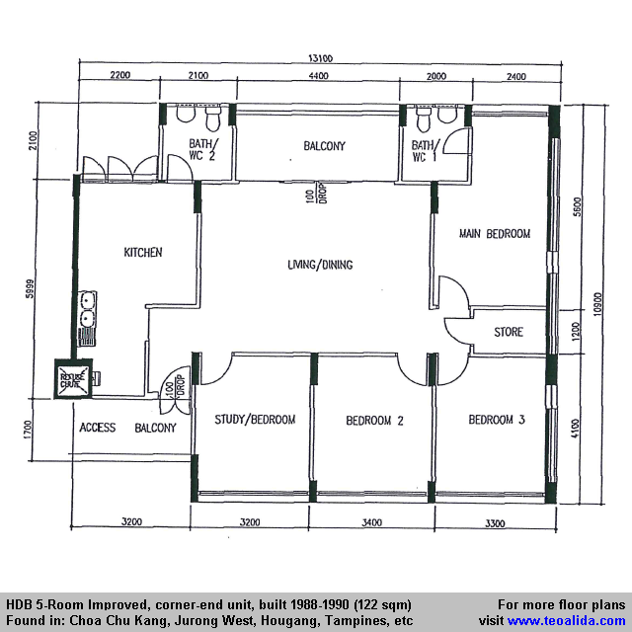
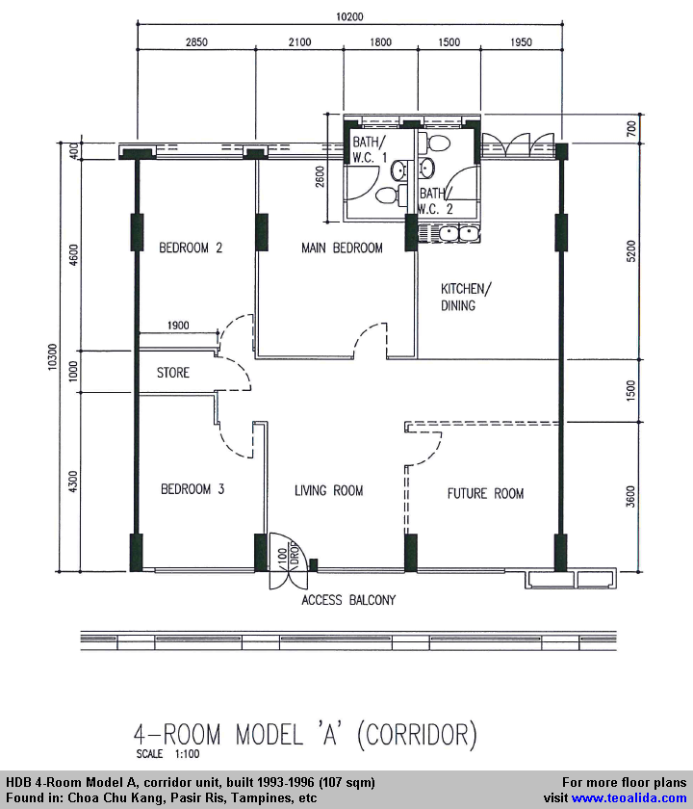
Flat Types examples
Notes:
Here are some sizes of the different flat types in Singapore

Slide 17
Least Meaningful Feature
Flat_model has mostly negative correlation to other features
Different models: May represent the same category of flat types.
Market Preferences: Buyers’ preferences and demands may be more towards spaciousness and rooms rather that the models.
Other factors: Changes to classifications, standardization towards floor area etc.
Notes:
As per the Correlation Matrix, we found that flat_model was the least meaningful.
This indicates that buyers tend not to consider flat_model when choosing their homes.
Furthermore, changes to policy and standardization makes this feature hard to track
Here’s an example: From 2024, the policy forward is to categorize new HDBs into these 3 categories. However, older estates will keep existing ones.
This complicates the feature due to the changing policies by the government.
We will use flat_type for our dashboard.

Slide 18
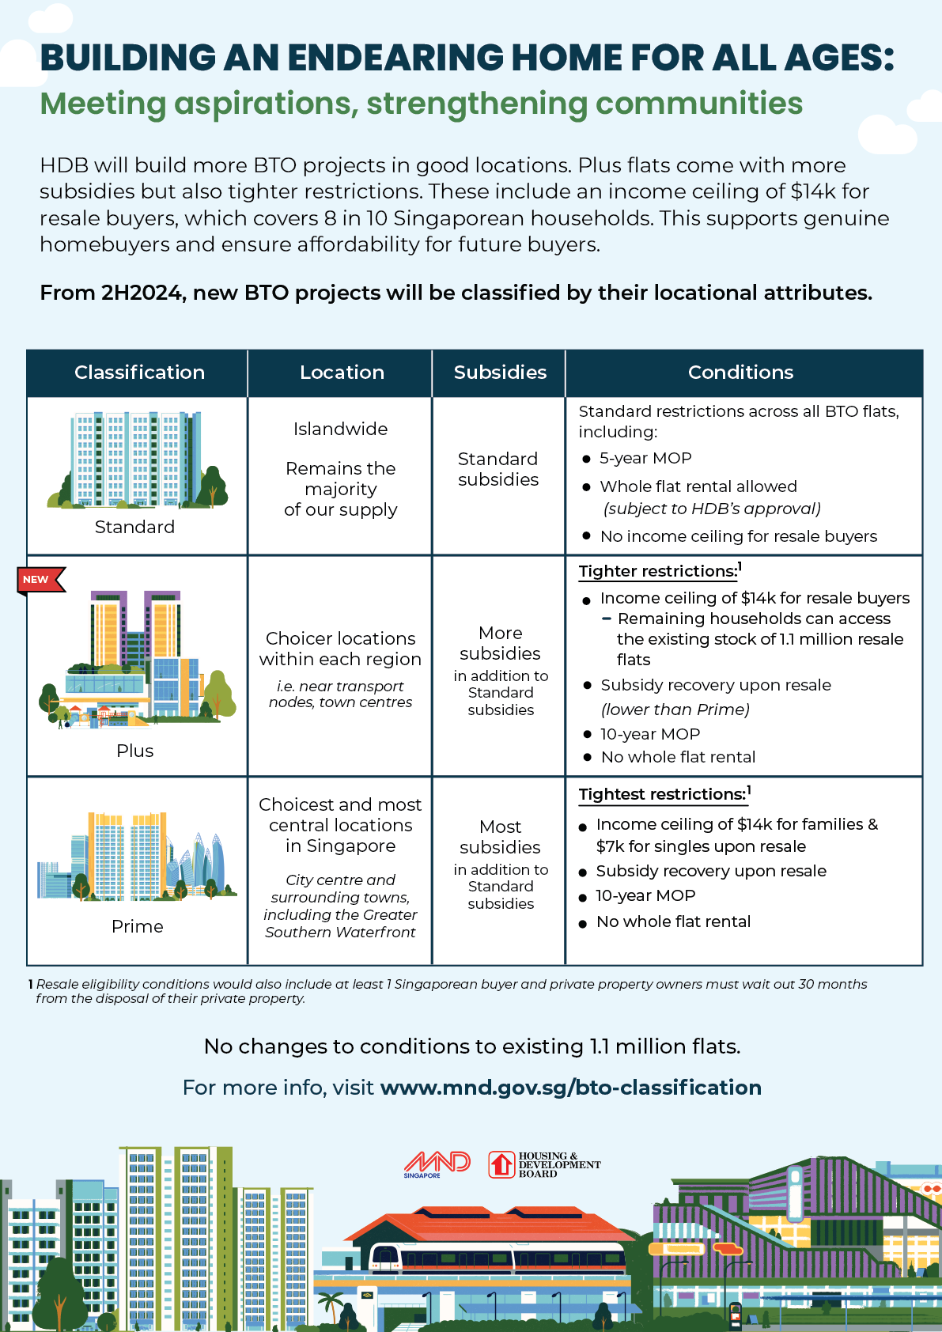
Least Meaningful Feature
New Public Housing Model: Also known as the new BTO classification
The new classification and Plus model will apply for future BTO projects. No changes will be applied for current for existing HDB flats or booked flats.

Slide 19
Tableau / Dashboard Explanation
Tableau / Dashboard Explanation

Slide 20
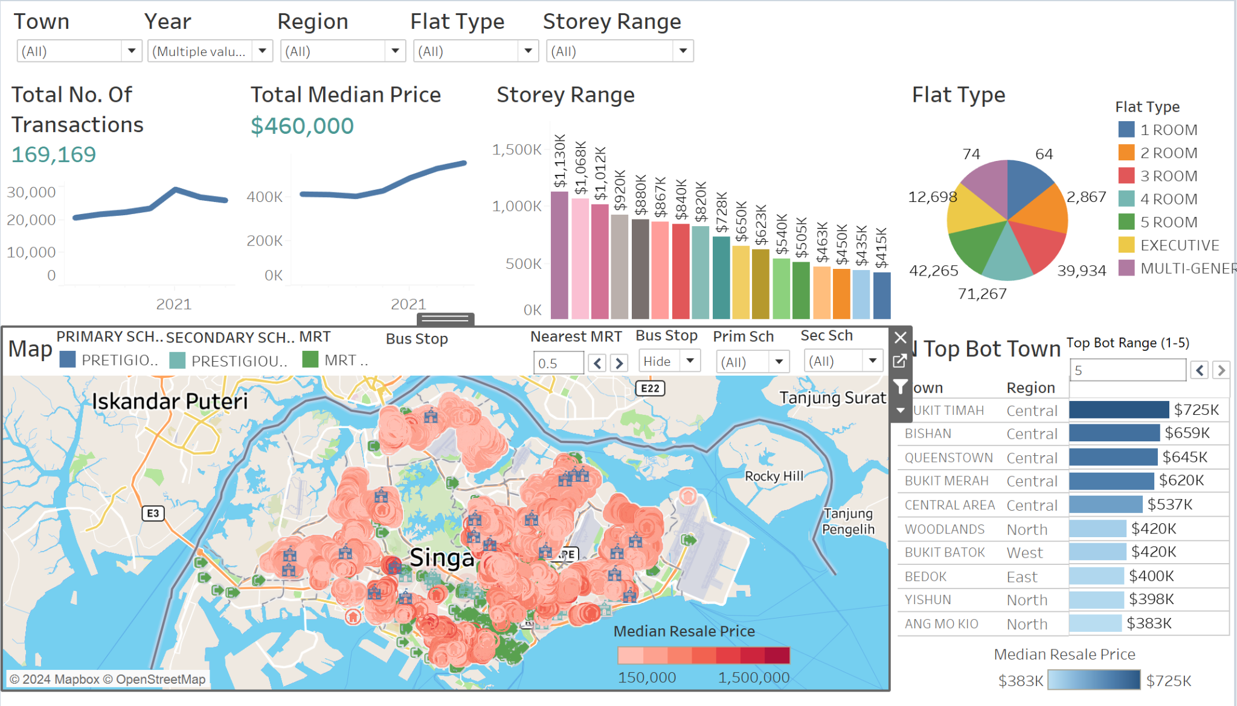
DASHBOARD OVERVIEW

Slide 21
Breaking down of the dashboard
Breaking down of the dashboard

Slide 22
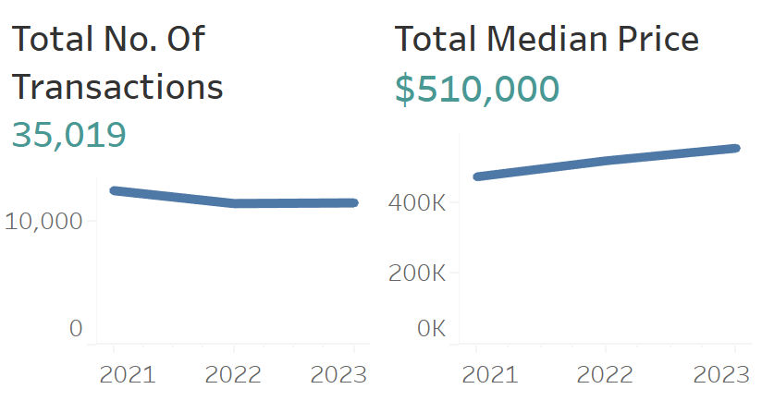
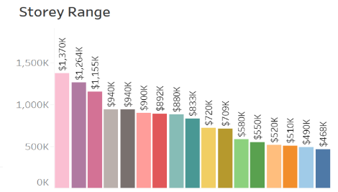
Filter To allow showing of more specific data in the dashboard.
Line Graph Used to help understand resale flat market trends, whether it is rising / falling in demands
Bar Graph To allow for comparison between the different storeys that the flats are on and the median pricing for that storey range.

Slide 23
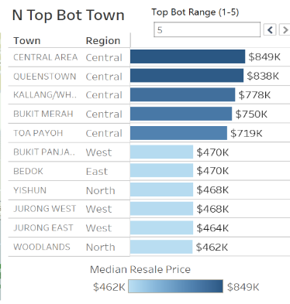
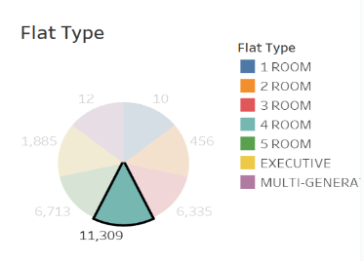
Top ( ) and bottom ( ) of towns in Singapore To show the comparison between selected top and bottom median resale flats pricing to help allow for better prediction in pricing of the housing’s resale value in a town
Pie chart To show the different transaction volumes of the different flat types in the resale e.g
4 Room Flat - 11,309 transacted units

Slide 24
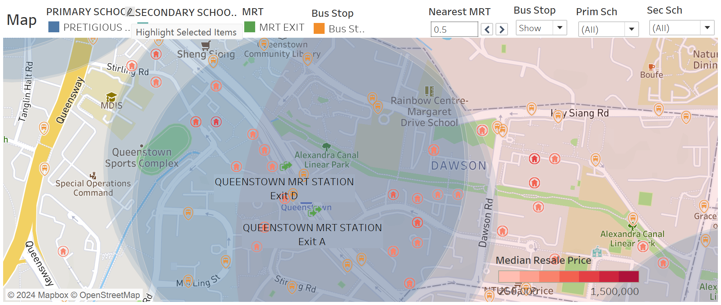
Map
Show Proximity to nearest:
MRT
Supermarket
Library
Schools
Other Amenities
To help visualise the difference in pricing of the houses based on the surrounding amenities, facilities and the distance between them and the houses

Slide 25
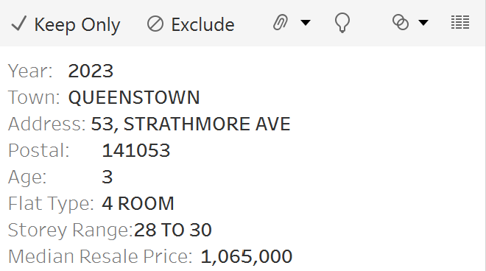
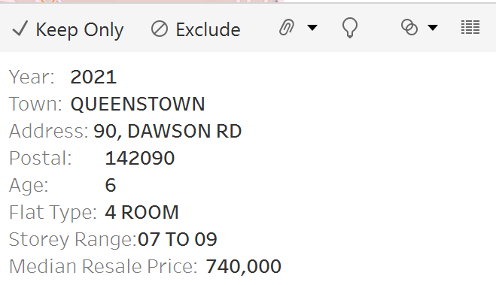
Map

Slide 26
Data to help us arrive at decision
Data to help us arrive at decision

Slide 27
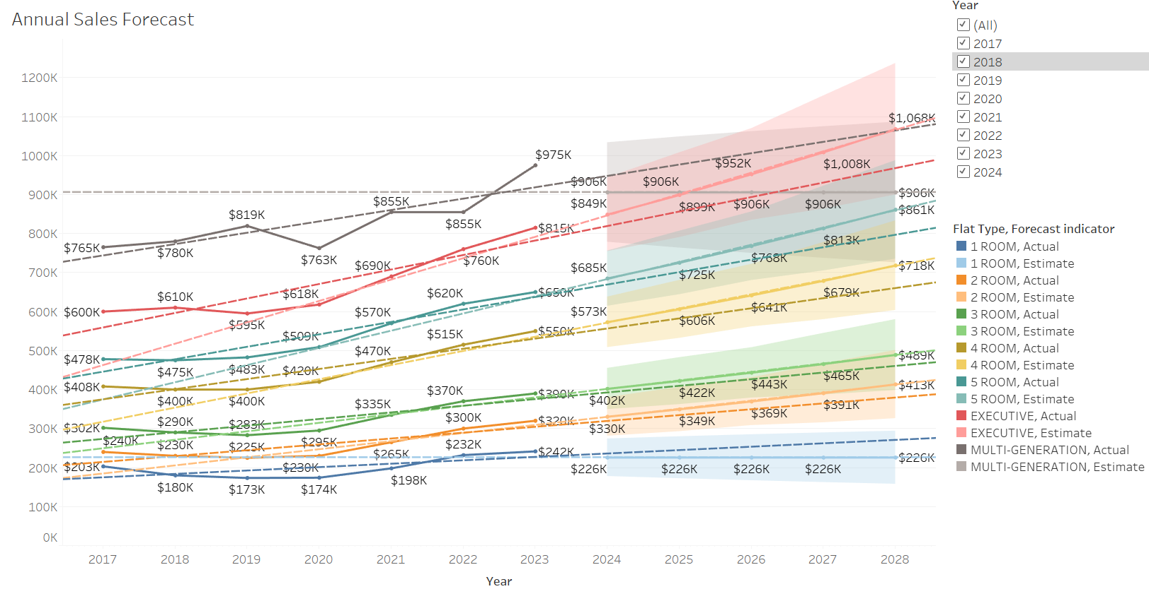
Market Trend Prediction
Not enough Transactions
Notes:
Historical sales trends and move to forecasted sales.
Market analysis for the changes in the trends such as sudden increase or decrease in sales for certain flat types.
Actual comparing with estimated figures to prove the impacts confidence in the forecasts.
Based on sales forecast, provide insights that could inform business decisions, such as which type of flats to invest in, to rent, or, to sell.
Not enough resale data on 1-room and Multi-generation Flats

Slide 28
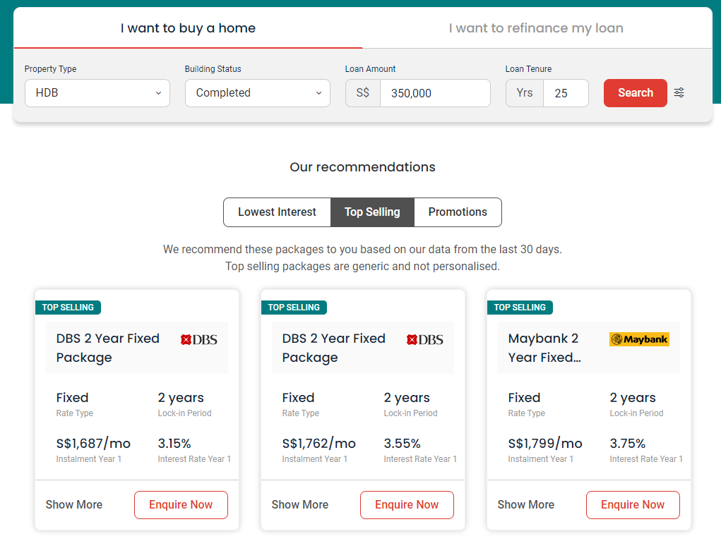
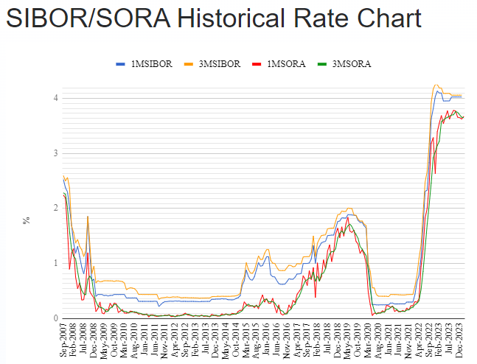
Rent or Sell?
Most popular bank loans for HDB are floating around 3% to 4%. (2024 est.)
We are using 4% to benchmark against the hdb resale price.
Singapore Inter-bank Offered Rate (SIBOR) is the average rate derived from the lending and borrowing rates quoted by financial institutions and announced on a daily basis.
Singapore Overnight Rate Average (SORA) is the weighted average of borrowing transaction between 8.00am and 6.15pm.
Notes:
Some external factors to consider when selling/renting.
When interest rates are higher, buyers will shy away from buying a home.
For our purpose, we should

Slide 29
How we determine the sell / rent
Making Recommendations
Rent vs. Sell Based on Forecast: If the forecast shows increasing property prices, we recommend holding and selling later.
Conversely, if the forecast shows stagnation or decline, we recommend renting as a preferable option to generate income while waiting for market conditions to improve.
In short, If prices are predicted to increase we recommend to sell in the near future while, if the prices are predicted to fall we recommend to rent it out till the prices stabilise
Notes:
Kaijie can help to check if its possible to immediate sell or must hold and sell
Rent: when stagnant/decline - external factors like higher loan interests - affect buying power, so more people might prefer renting instead.
Sell: when rising - market might be doing well - buyers have more confidence as they might be able to afford it

Slide 30
Conclusion
Conclusion

Slide 31
Conclusion
By using the dashboard, the realtors/owners can use the data to help make an informed decision to either sell or rent their apartments.
With the prediction graph, they can confidently list their prices accordingly.
Since 2024, more HDBs are being built and this will definitely affect the market. HDBs in central location are only having their MOP lifted, so progressively we will see more resale records on higher stories flats and make a better decisions on when it is updated to all the future sales

Slide 32
The end
The end
— Group 3 —

Slide 33
References
https://www.propertyguru.com.sg/mortgage/home-loan/hdb-loan
Circuit Breaker - COVID
https://www.99.co/singapore/insider/new-public-housing-model-hdb-resale-price/
https://www.99.co/singapore/insider/hdb-bto-classification/
https://www.mnd.gov.sg/our-work/housing-a-nation/bto-classification

